Slide 1

Grade Wines
IDS 702 Final Project Presentation – Maobin Guo

Slide 2
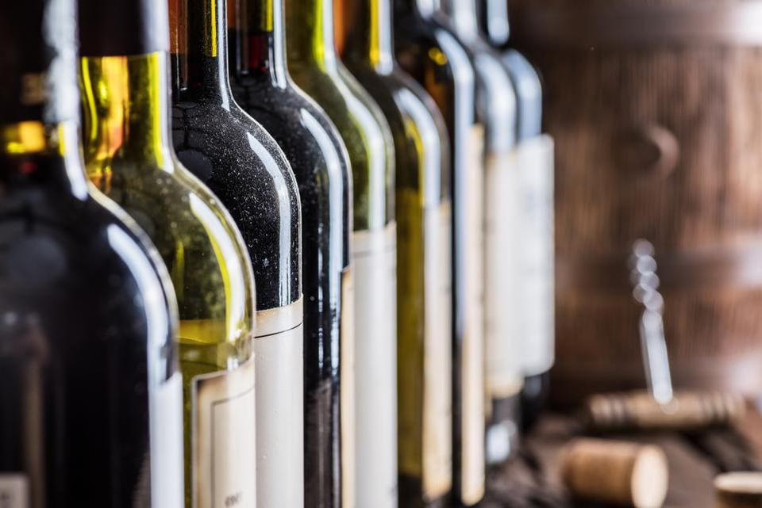
Questions :
01
Which feature effect wine's flavor most ?
02
Which feature plays different roles in read wine and white wines
03
Is sulfur dioxide free wine taste better ?

Slide 3
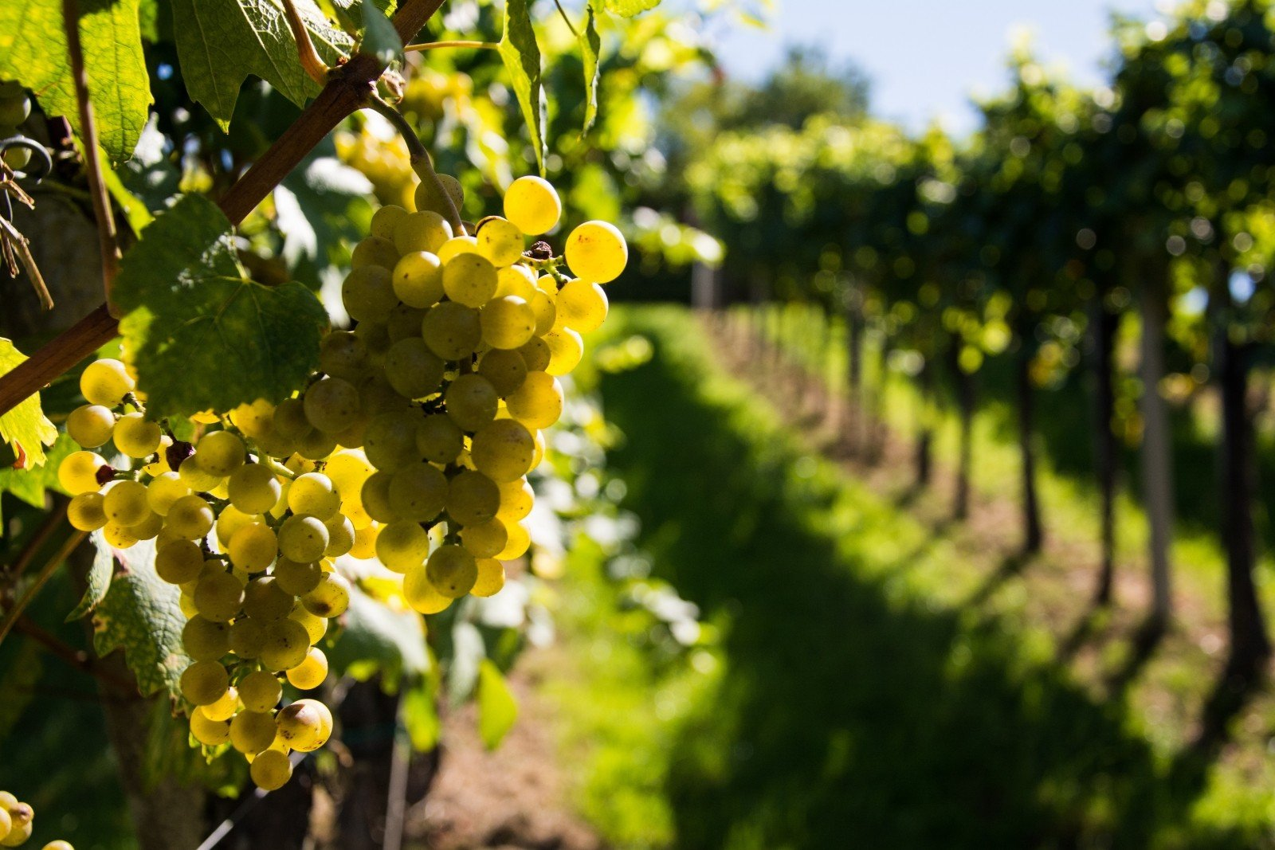
Backgroud and Data
Portuguese “Vinho Verde” wine
Red Wine : 1,599 observations
White Wine: 4,898 observations
Three grades:
Acceptable, Good and Premium
Predictors: 9 physicochemical properties
pH, citric acid, residual sugar, etc.

Slide 4

Exploratory Data Analysis
I. Many interactions between red wine and white wine.
II. There is no high correlation between predictors.

Slide 5
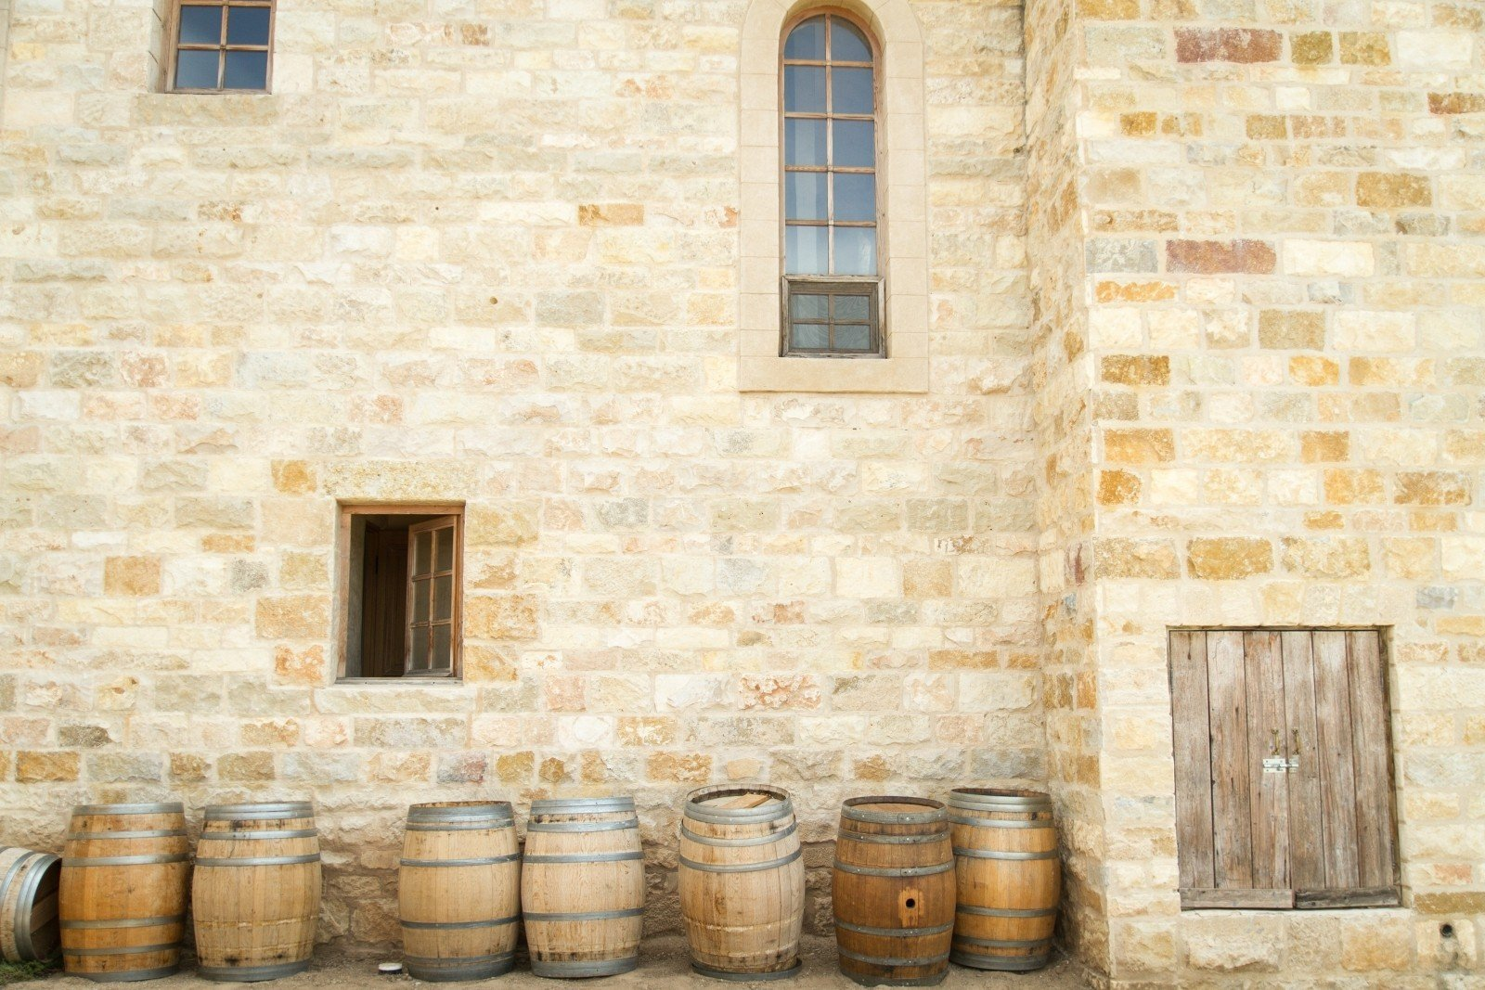
Final Model

Slide 6
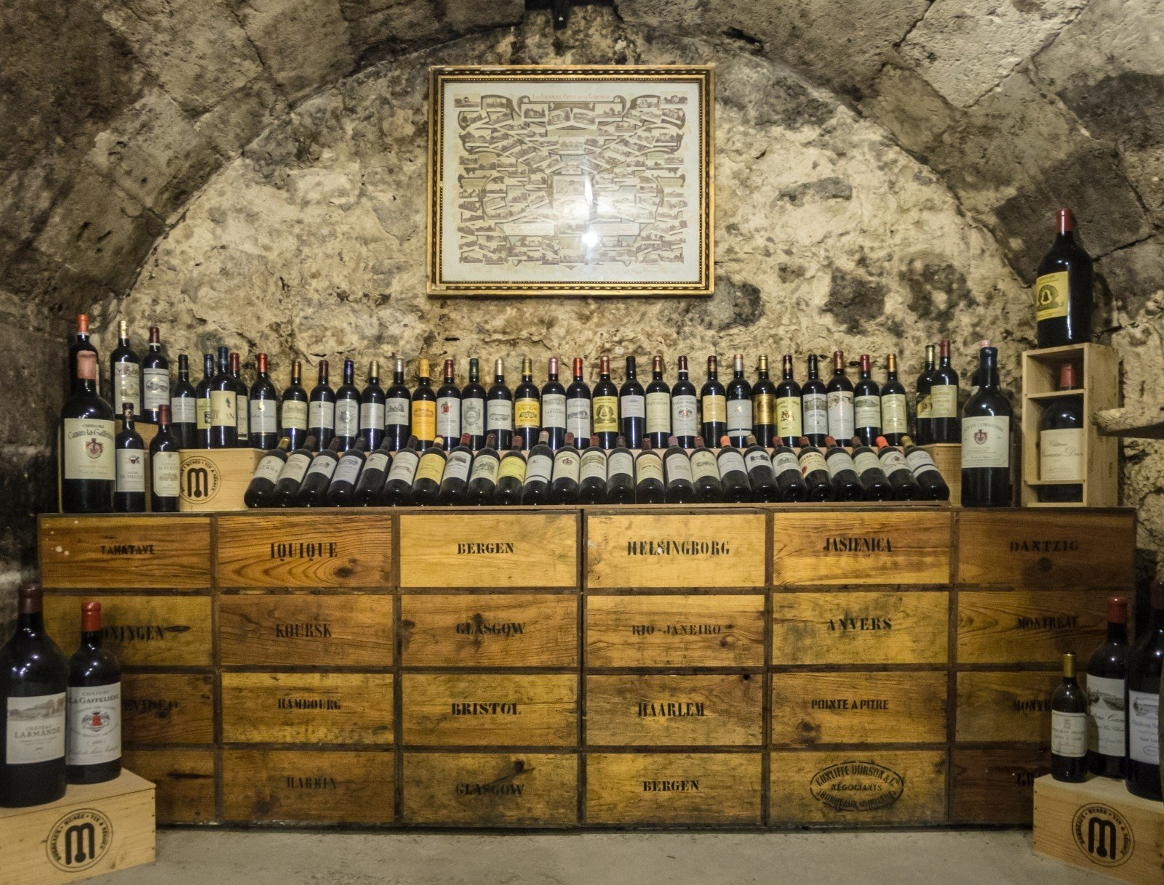
Model Assessment

Slide 7
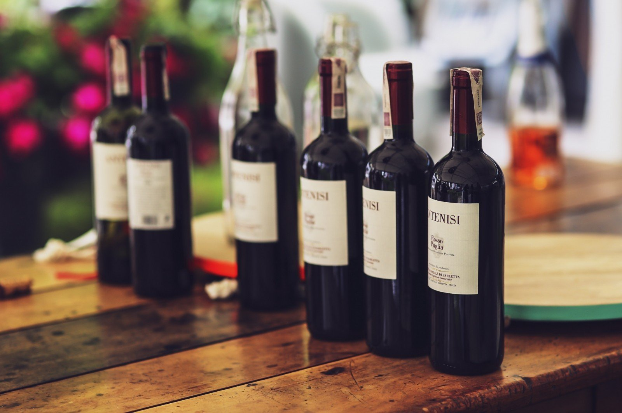

Interesting Findings
Alcohol content is the most import the factor for both red wine and white wine. The higher the better.
Important factors for red wine:
low volatile acidity > high sulphates > low citric acid
Important factors for white wine:
low volatile acidity > high citric acid > low sulphates > high pH
Sulfur dioxide has nothing to do with the taste of wine.

Slide 8

Limitations & Future Works
Sample size of red wine and white wine is imbalanced.
The classification accuracy for good and premium is not satisfactory.
Sophisticated machine learning methods can be used in future
studies

Slide 9

Toast

